Slide 1
JetBot Collision Avoidance powered by Jetson Nano
2023 Mike Soniat

Slide 2
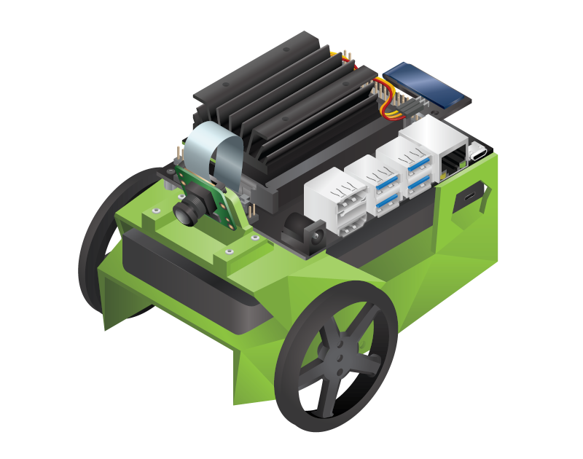
JetBot JetBot is an open-source robot based on NVIDIA Jetson Nano. https://jetbot.org

Slide 3
Project
Experiment with machine vision and deep learning using the JetBot, Python, JupyterLab, PyTorch, and OpenCV.
Keep the robot within a “safe” area and out of “unsafe” areas.
Build a neural network using images from the JetBot’s camera.
Collect 300 images, using the JetBot camera, and label or classify them as either “Blocked” or “Free”.
Train a model using the classified images to detect safe and unsafe areas.
Use this model to let the JetBot loose in the environment and see if it can stay clear of danger (falling off the table).

Slide 4
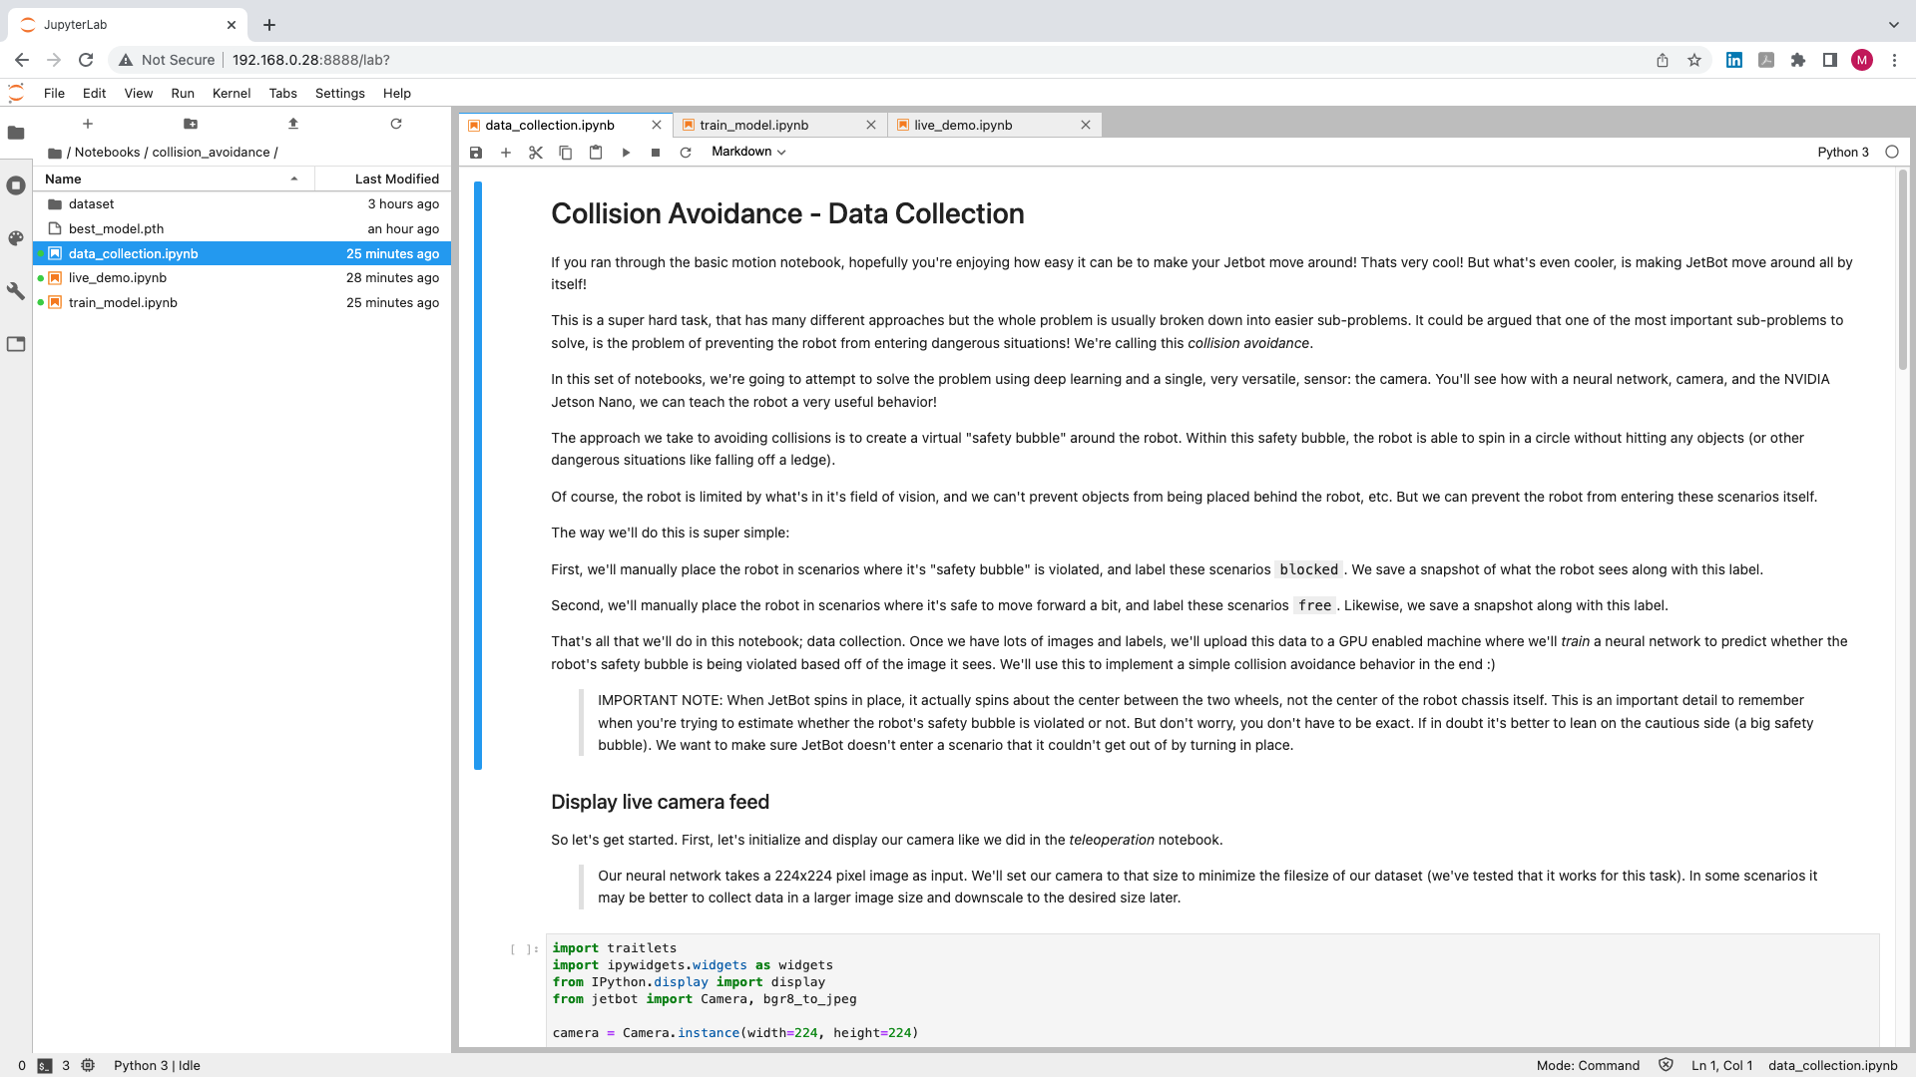
JupyterLab Notebook

Slide 5
Data Collection

Slide 6
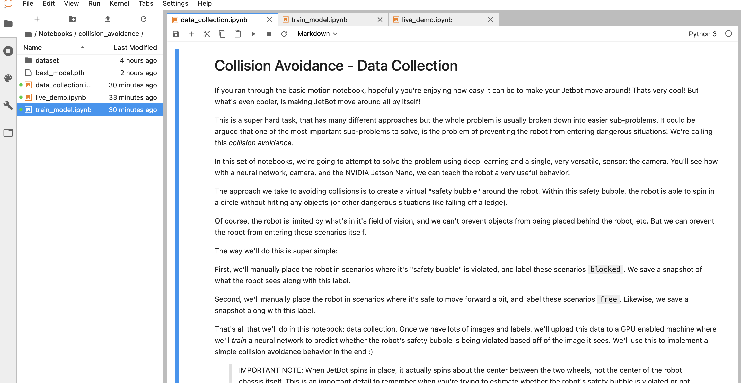

Slide 7
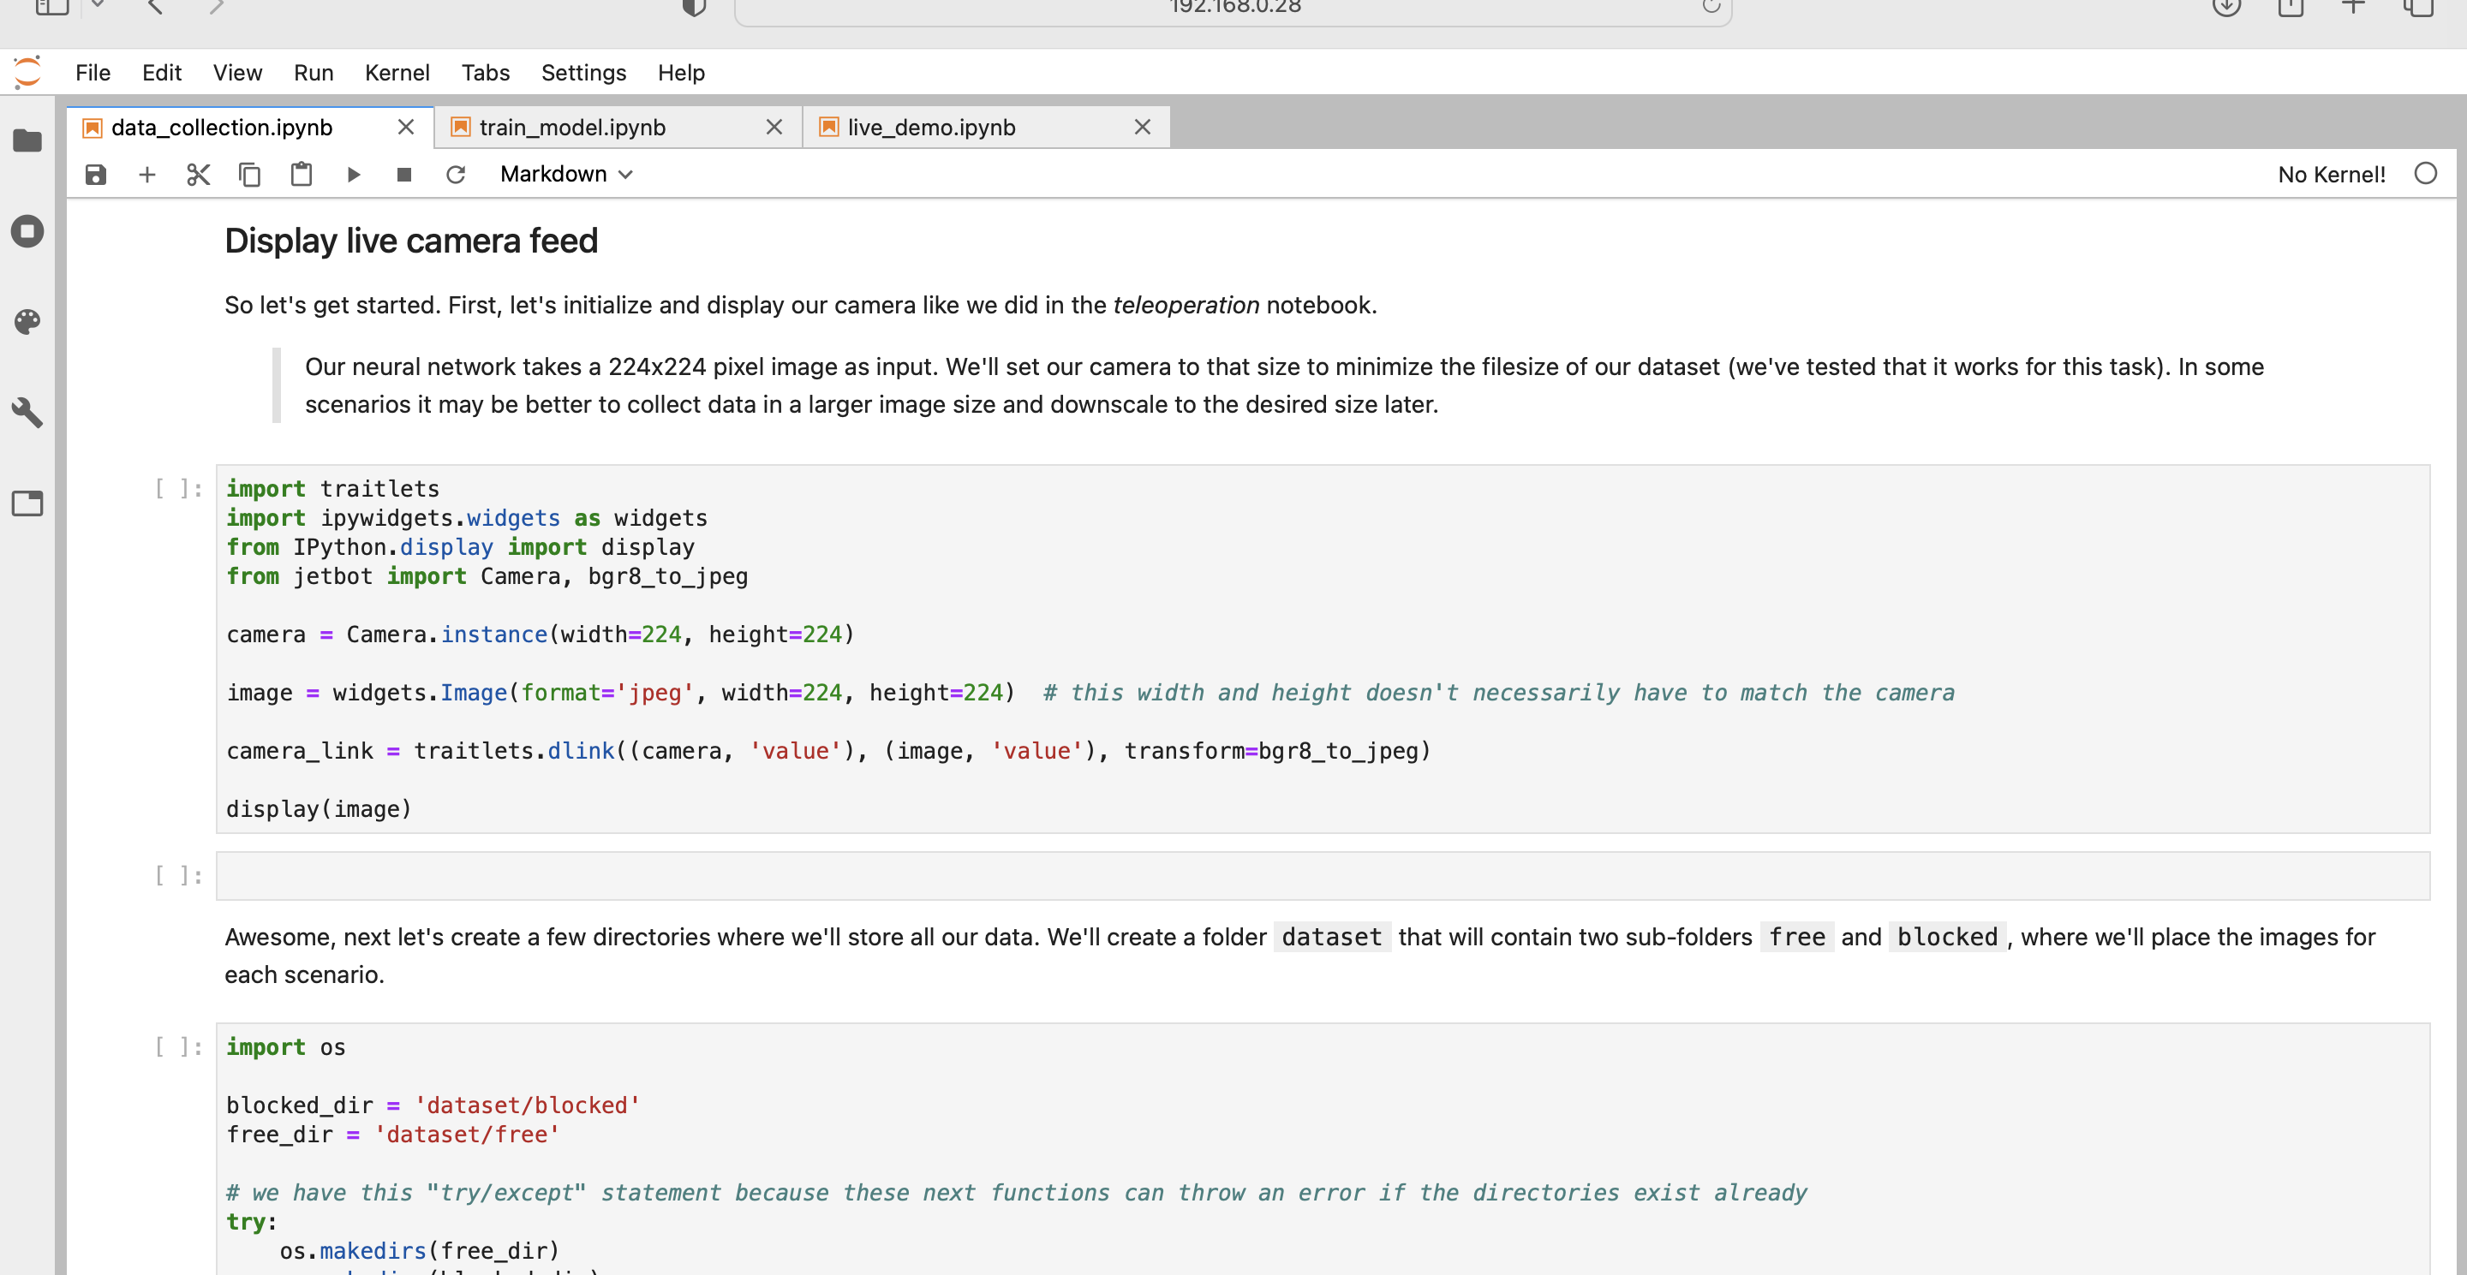

Slide 8
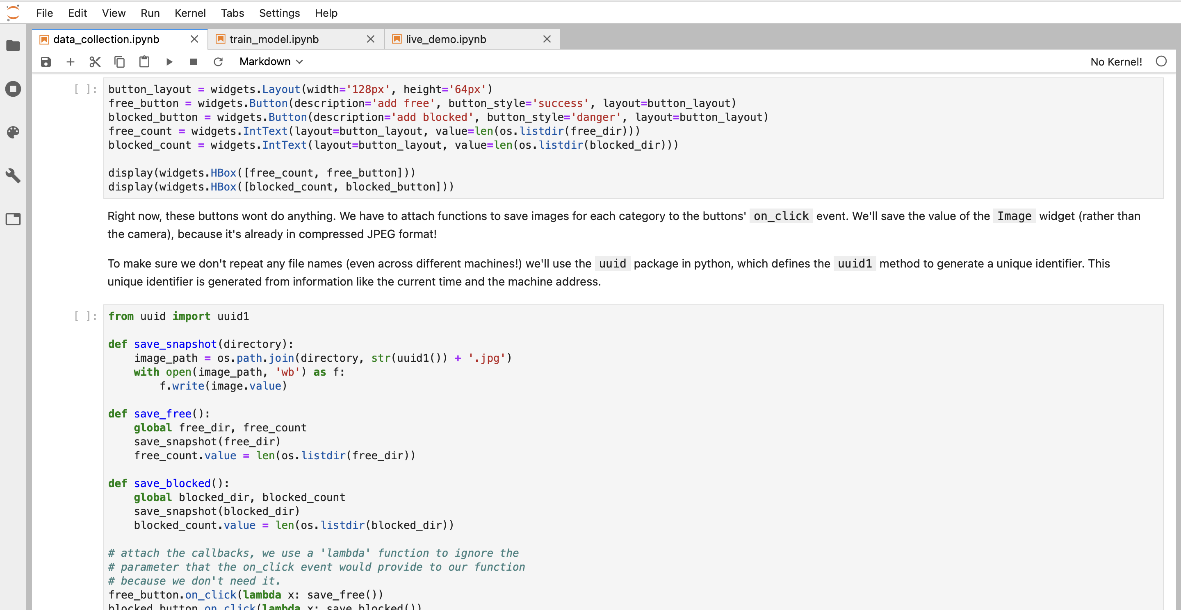

Slide 9
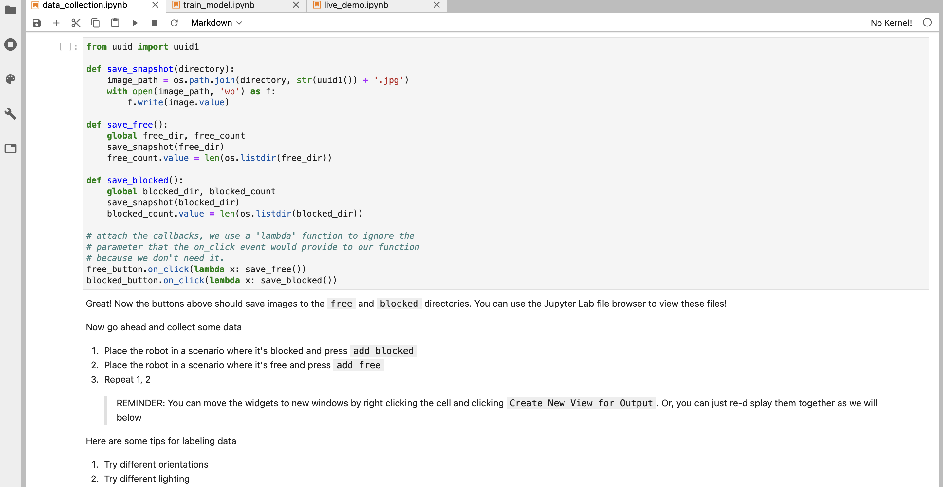

Slide 10
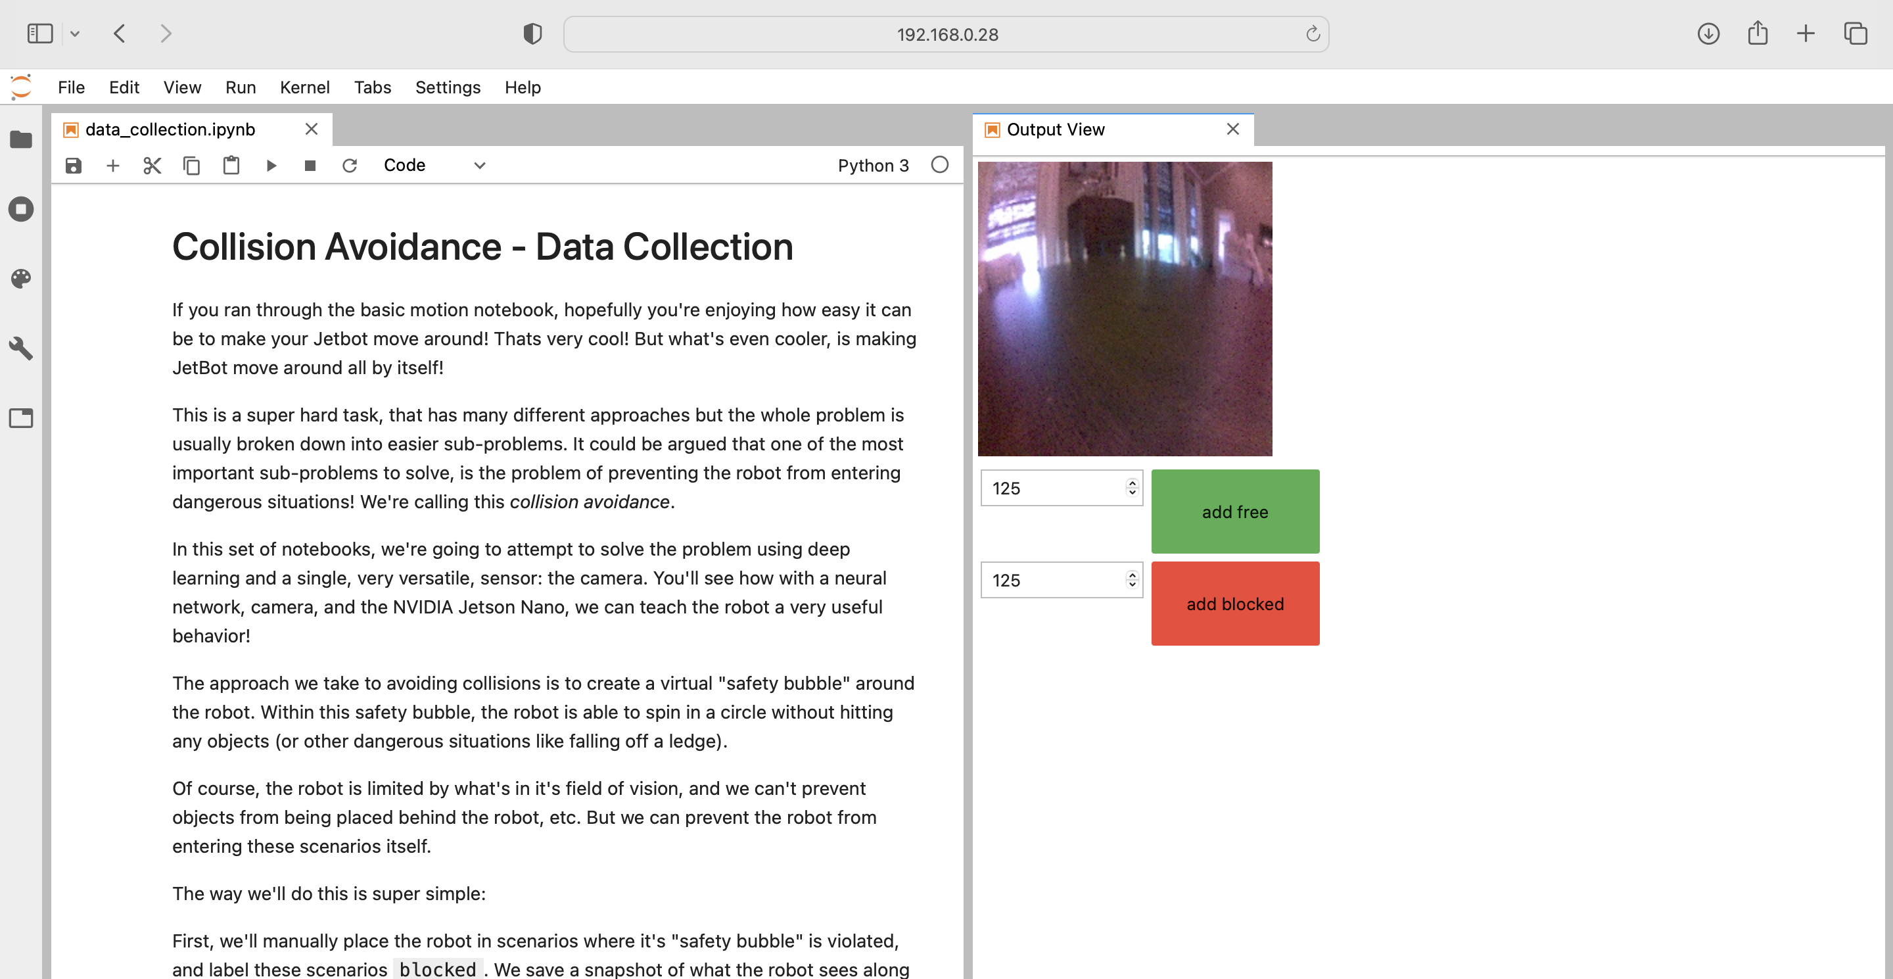

Slide 11
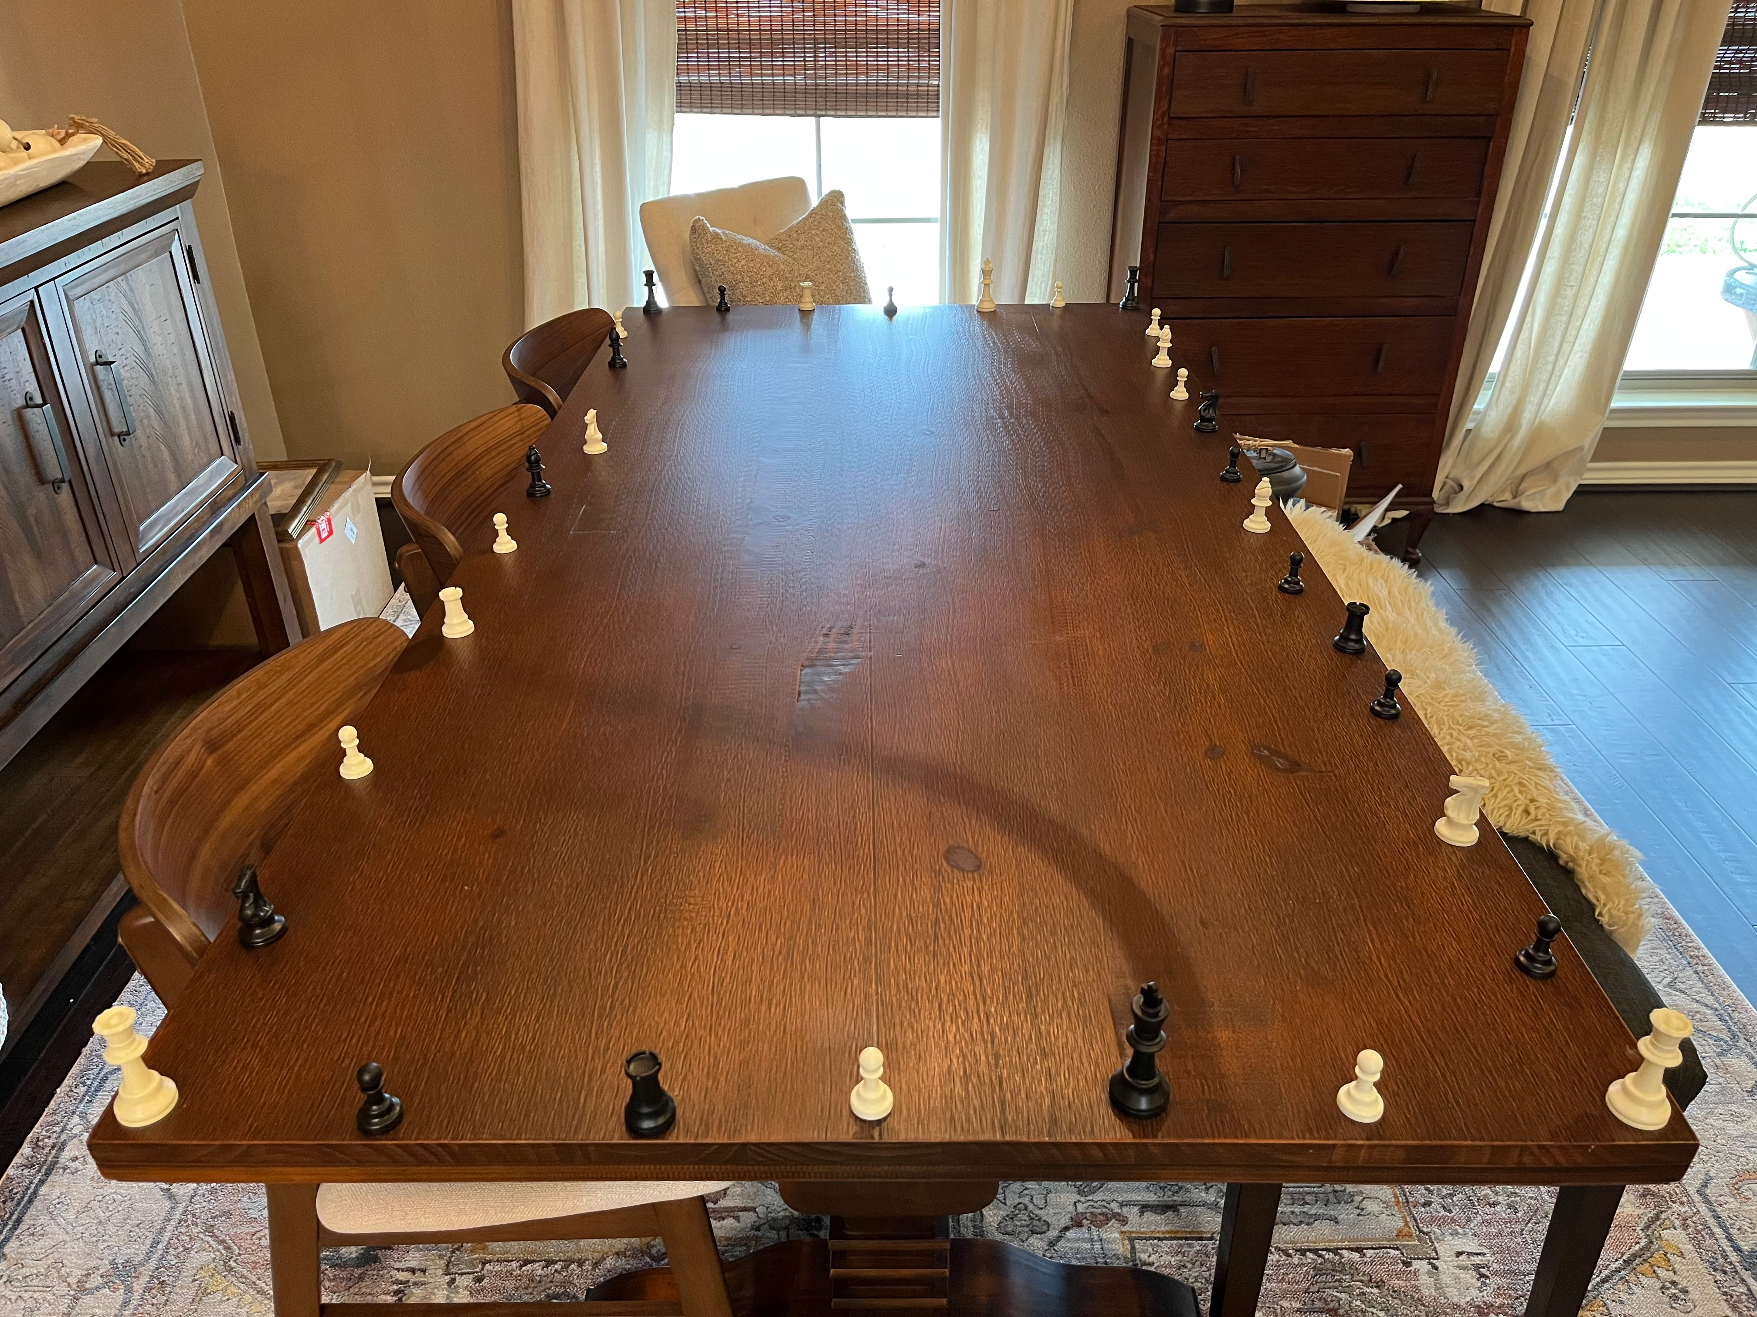
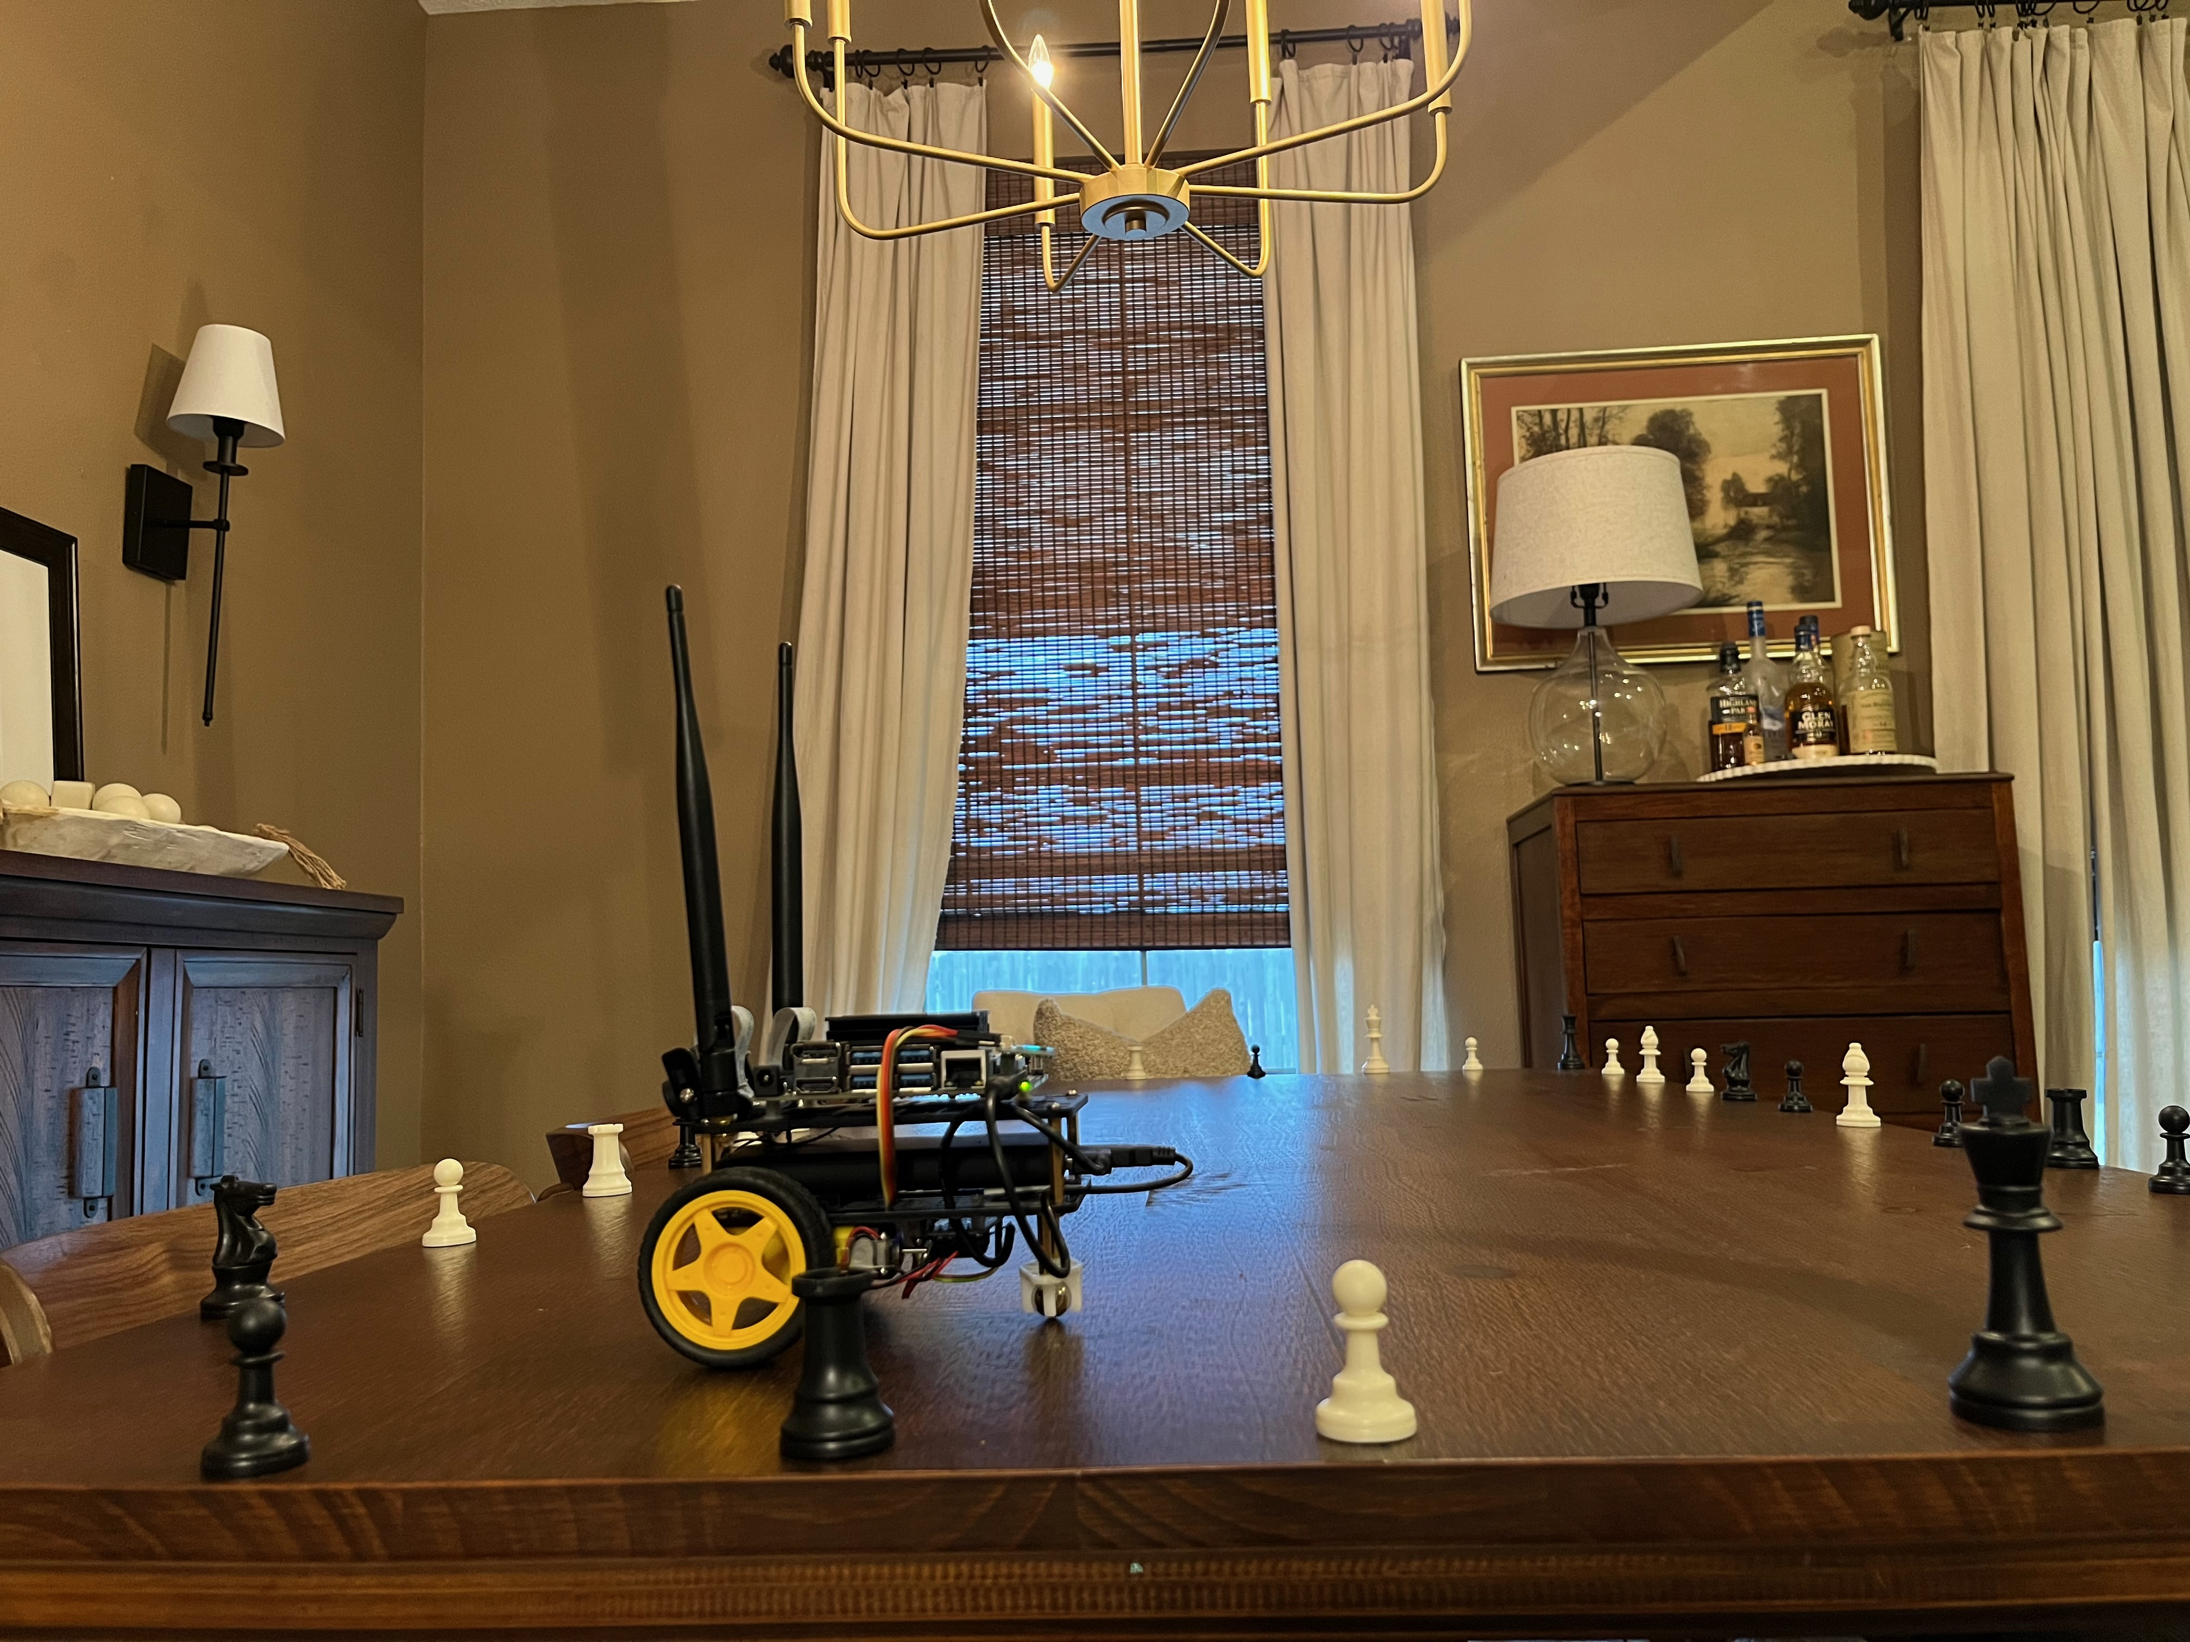
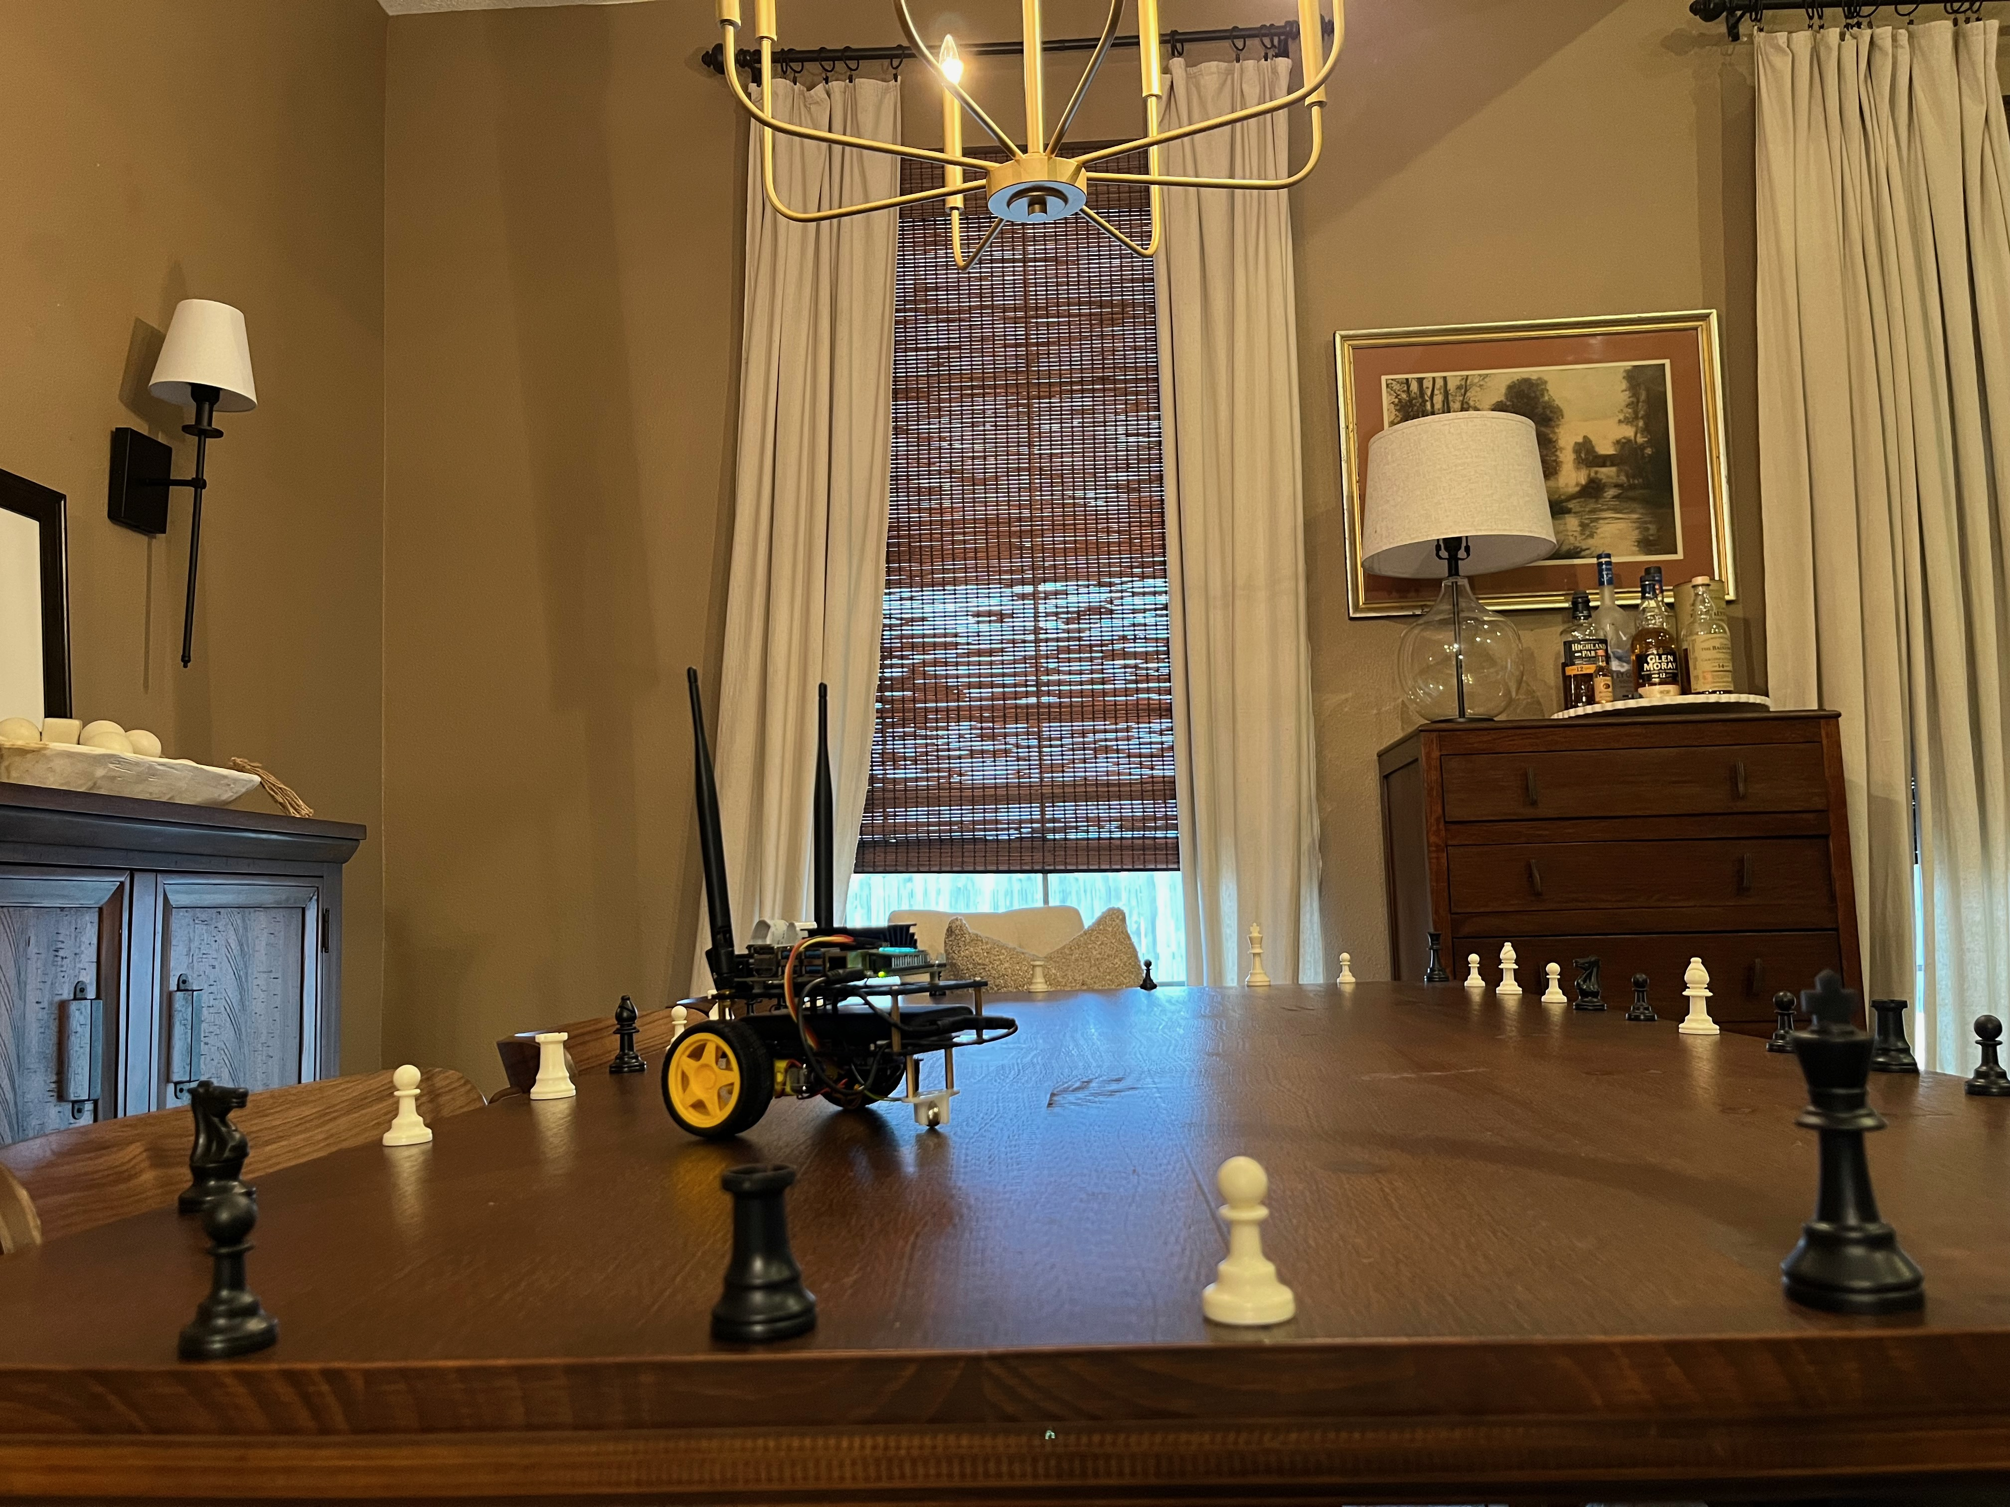
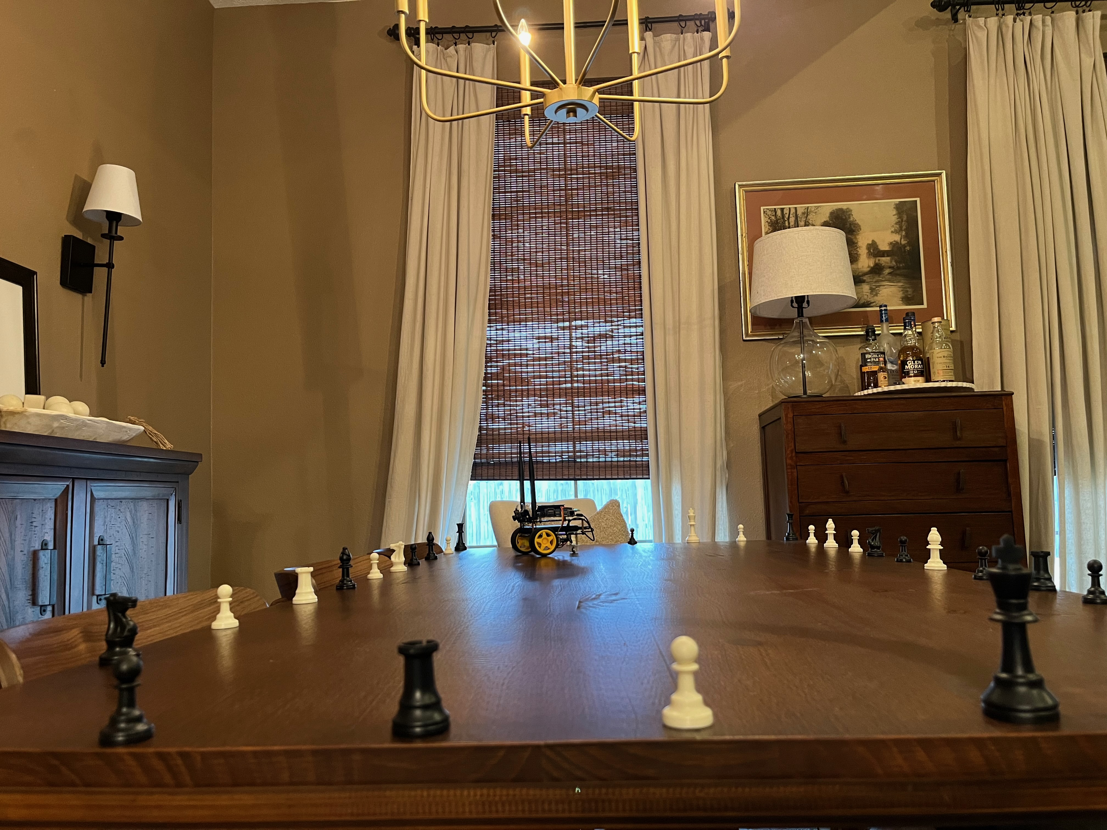
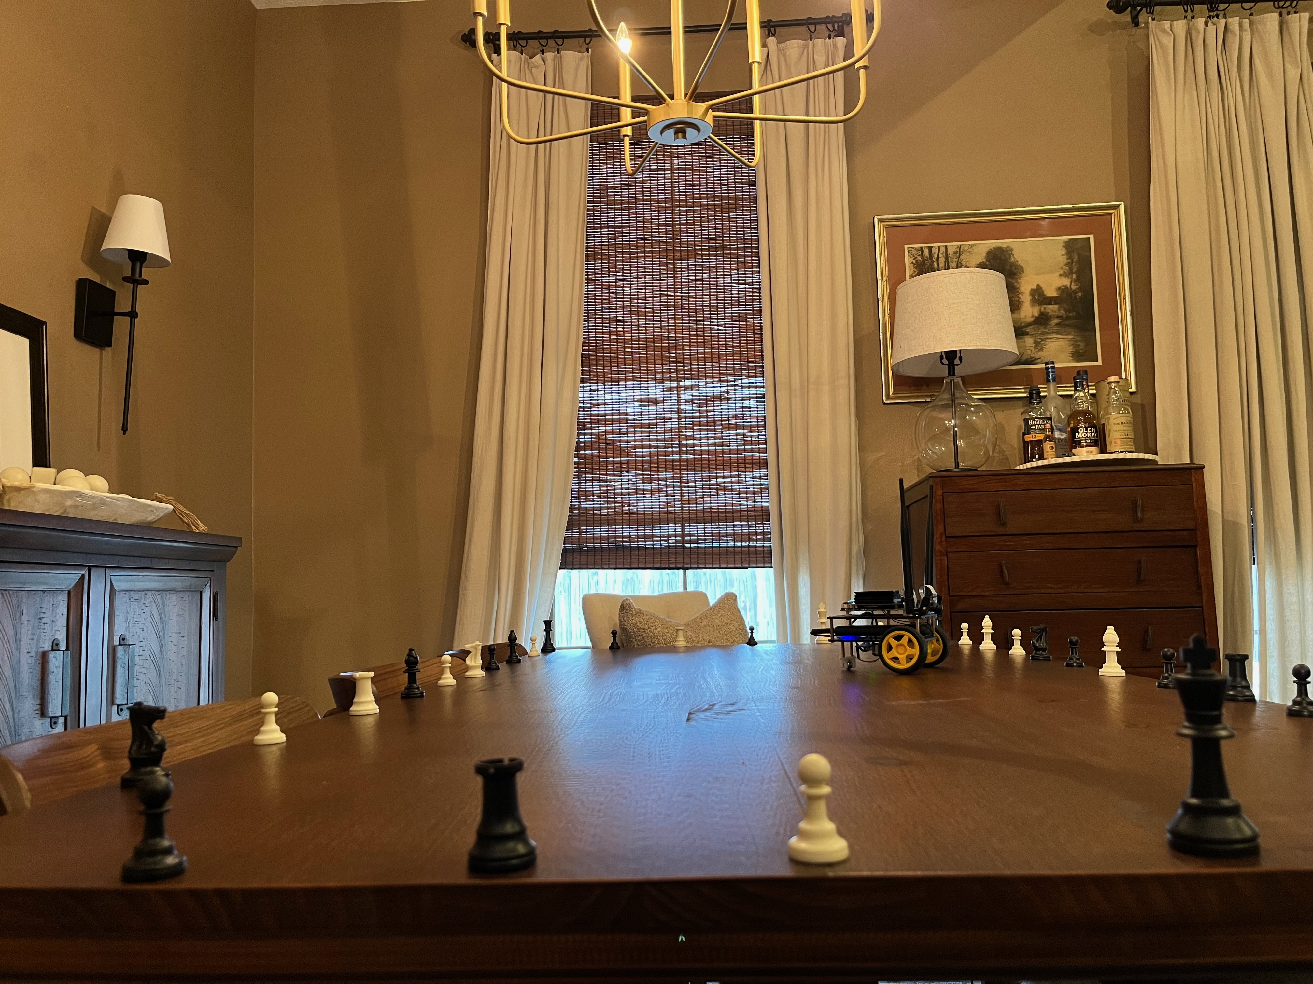
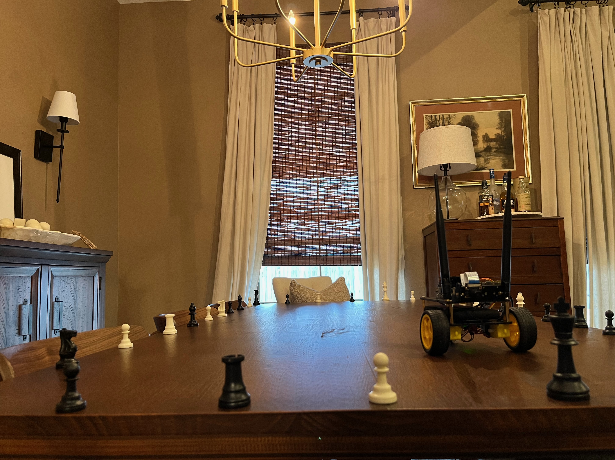

Slide 12
Train Model

Slide 13
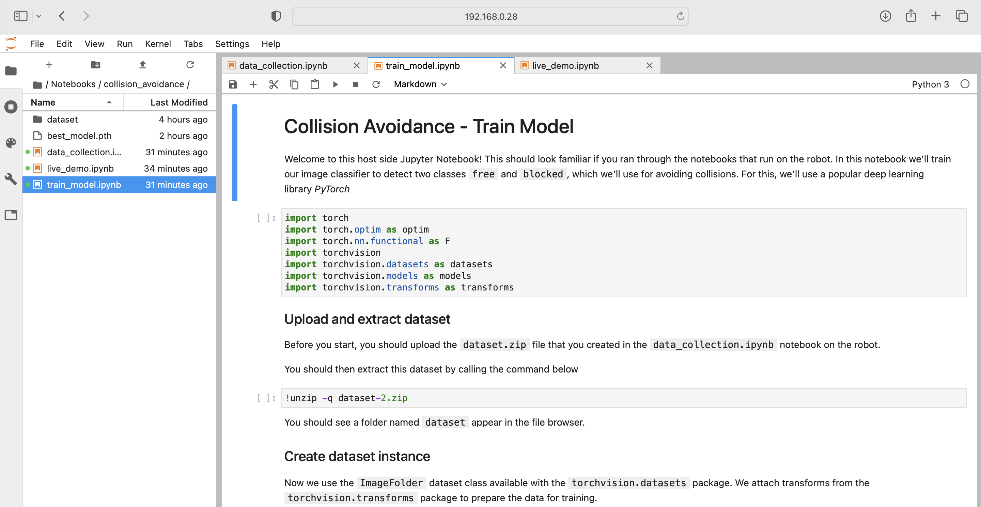

Slide 14
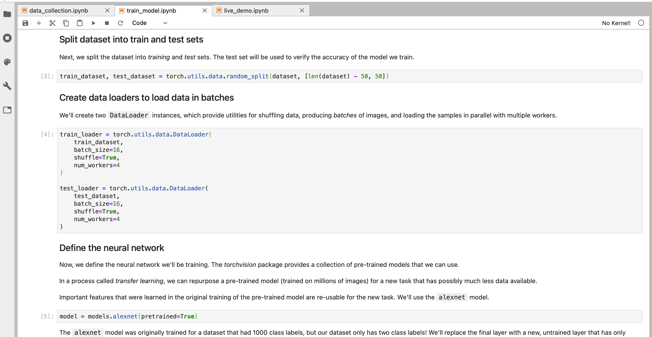

Slide 15
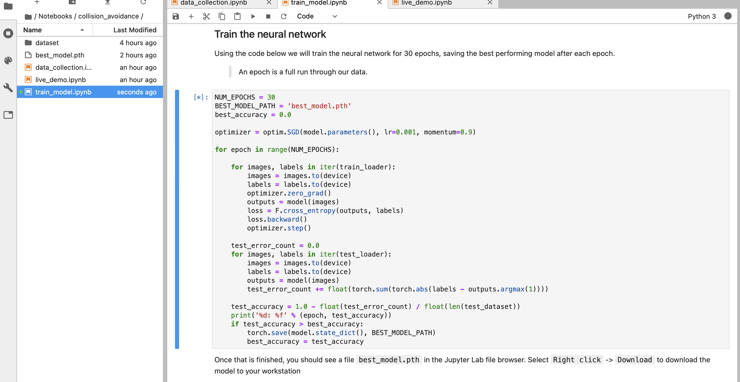

Slide 16
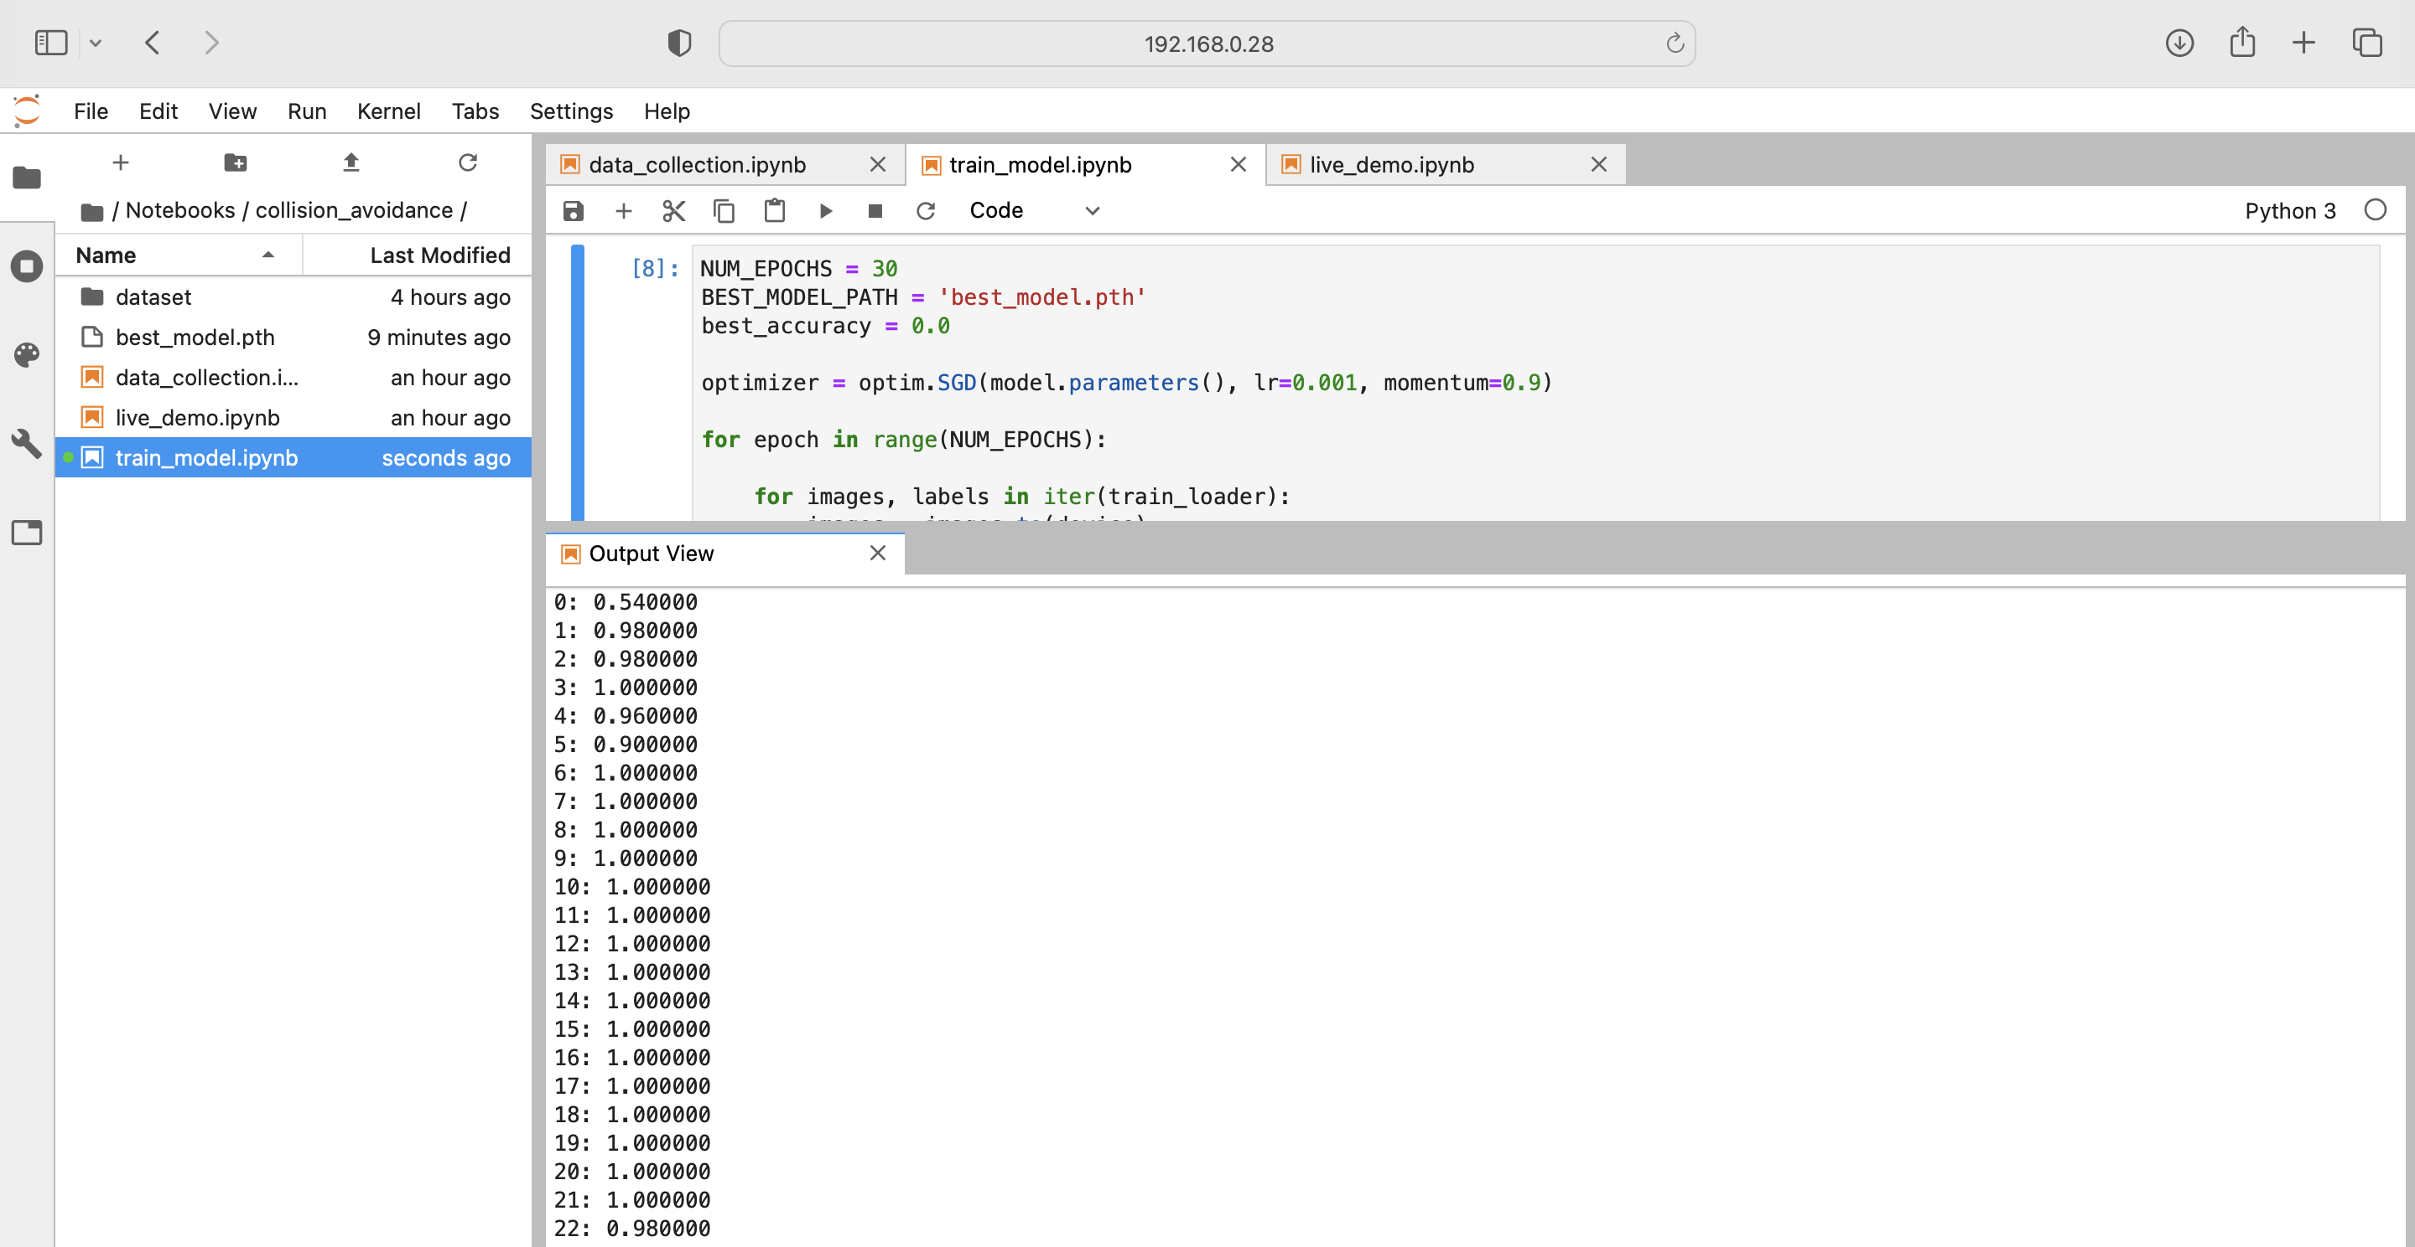

Slide 17
Live Demo

Slide 18
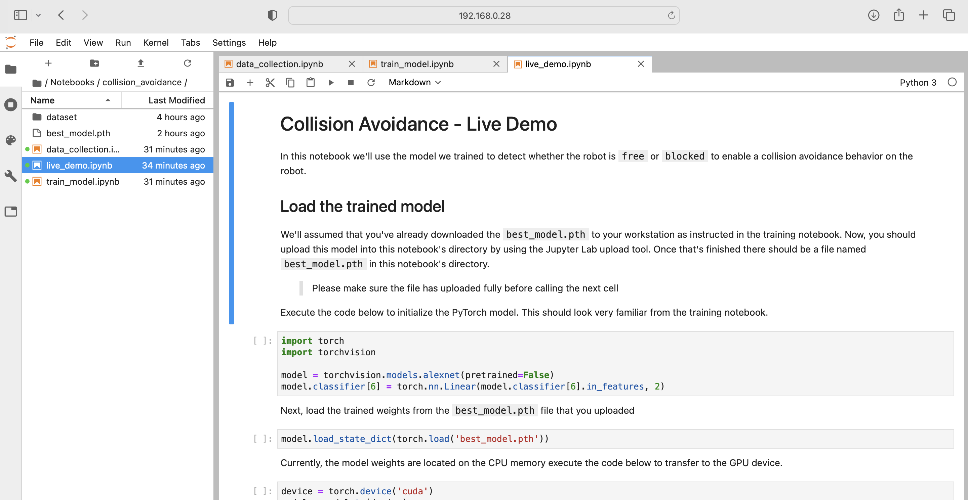

Slide 19
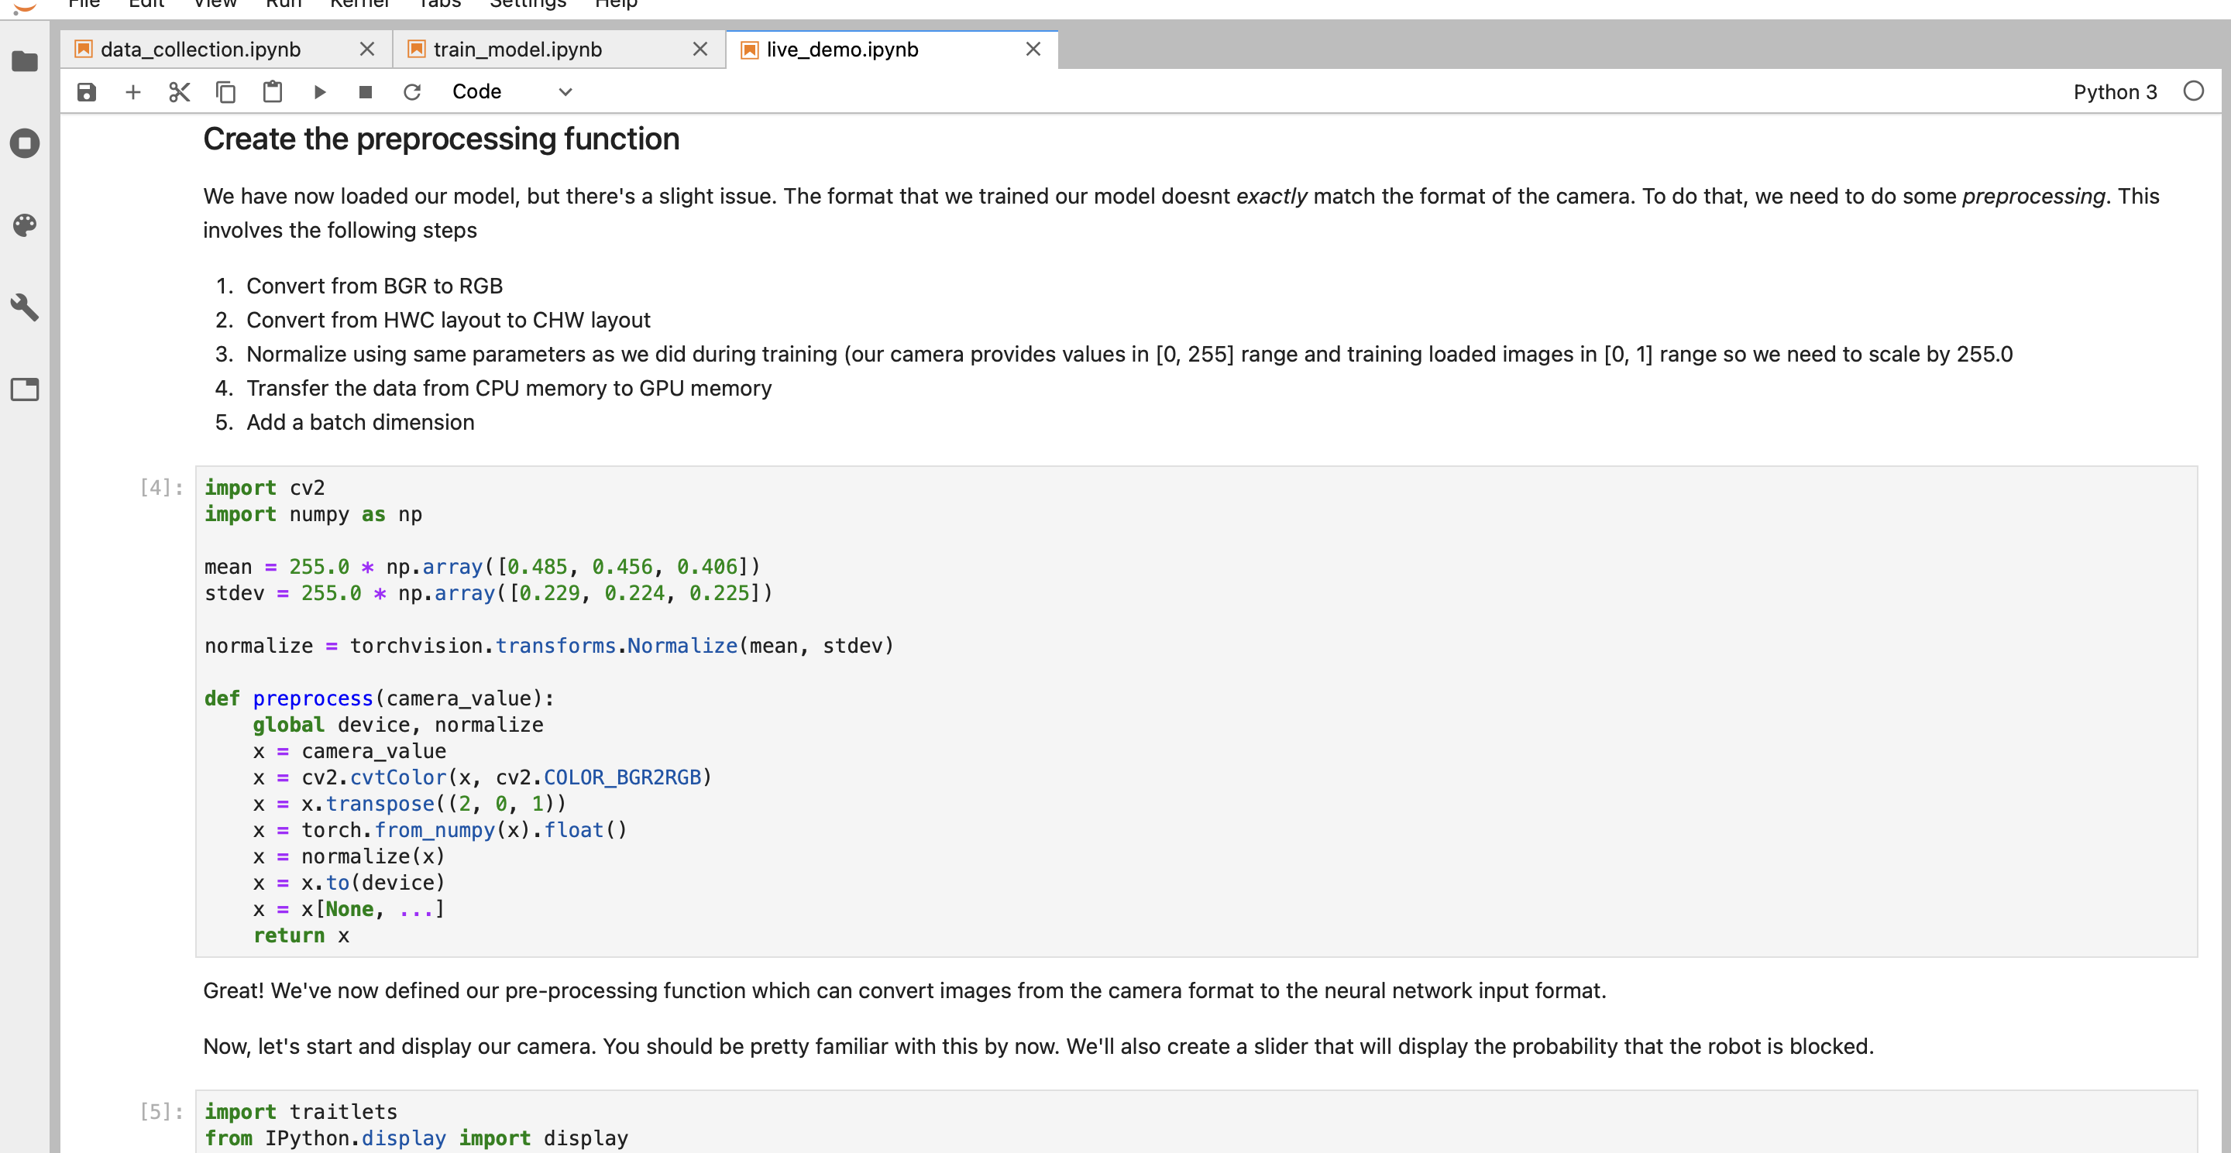

Slide 20
